Slide 1
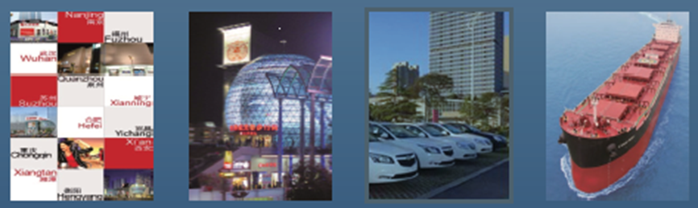
First Steamship Co., Ltd. Investors’ Conference
2023/12/14

Slide 2
Disclaimer
The contents in this presentation and relevant messages issued at the same time were obtained from the company’s internal and external information such as operation results, financial status, business development, etc.
The company does not release any financial forecast. However, the description involving the company’s opinions on its future operation and industrial development in respect of the company’s finance, business and Q&A made in this presentation could be different from the future actual results. The reasons for such differences may include changes in market demand, price fluctuations, competition behavior, international economic situation, exchange rate fluctuations, upstream and downstream supply chain, and other risk factors which are out of the company’s control.
The future outlook in this presentation reflects the company’s views on the future to this day. The company will not be responsible to send reminders or make updates for any future change or adjustment in those views.

Slide 3
Agenda
Company Profile
Group Overview
Business Development
Financial Summary
Business Vision

Slide 4
Company Profile
Basic Info
Inception Date: 1963/10/8
Listed Date: 1965/11/4
Capital: NT$8,247,760,670
Stock Symbol: 2601
Business
Operation includes shipping, retail, financial leases, property development, and financial services
Source: Financial Report as at 2023/9/30

Slide 5
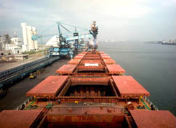


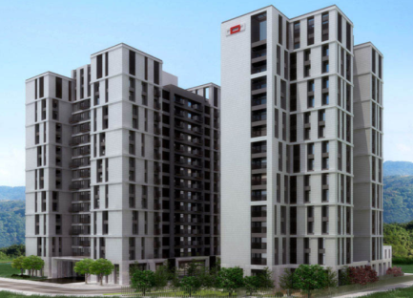


Group Overview
Shipping
Retail
Financial
Leasing
1963
2006
Grand Ocean
2013
Mariner Finance
Property
Development
Financial
Service
Group
Holding
2015
RSW
2019
Da Yu Financial
2017 Sandmartin

Slide 6
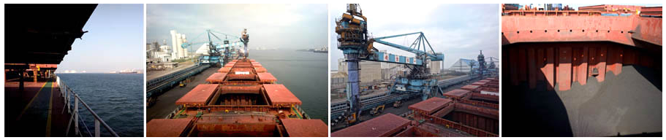

Business Development : Shipping (1)
Self-own fleet dedicated in the dry bulk ship market
Currently own 11 vessels: 2 Handysize-type, 5 Kamsarmax-type, and 4 Supramax-type.
Maintain high operation flexibility by switching between time charter model and joint-pool operation model as well as effective vessel asset management.
Strengthen E-management and maintenance effectiveness , lowering operation costs and boosting operation efficiency.

Slide 7
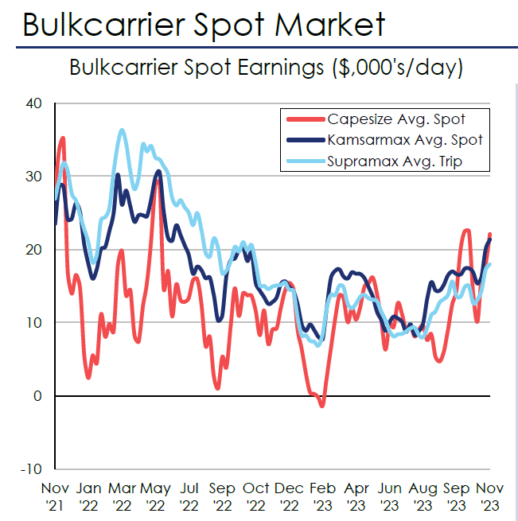
Business Development : Shipping (2)
Baltic Dry Index
Baltic Dry Index has begun to decline since 2022.

Slide 8
Business Development : Shipping (3)
Among 11 ships in the fleet, 2 are under long-term rental contracts with duration above 2 years, 1 is under pool operation, and the other 8 are under one-year contracts, which allocation will bring stable revenues and decrease market risks.

Slide 9
Business Development : Shipping (4)
Gross Profit of Shipping Department
USD thousand

Slide 10
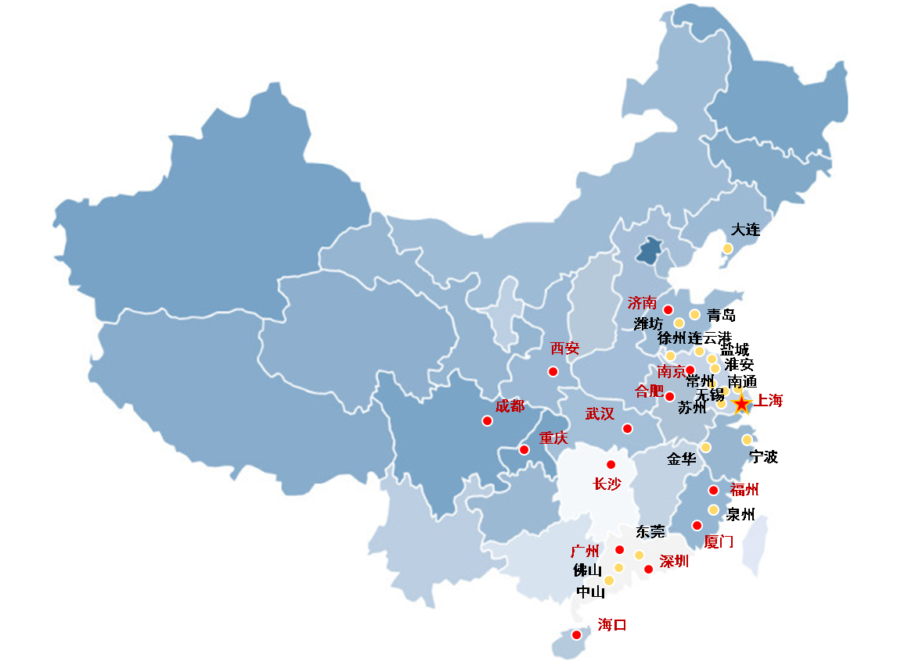
Business Development ：Mariner Finance Ltd.
Provides financial leasing service for businesses and for individuals, including but not limited to new car leasing
As of 2023/9/30
  Operations in 24 major cities
  Loan receivable amounts to RMB 175 million
  Auto leases: 2159
  Shanghai auto license plates: 161

Slide 11

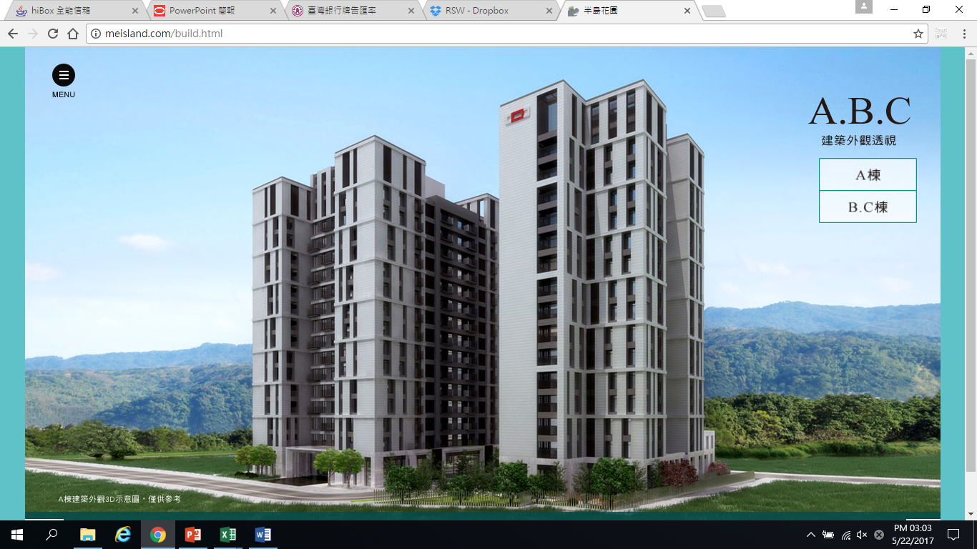
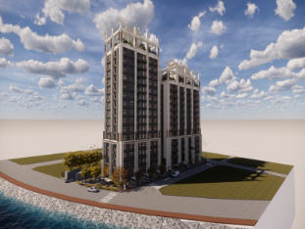

Business Development: Royal Sunway
Expert in rental and sale of real estates, and investments in infrastructure, in new town development, and in new community development, etc.
“River & Tree” JV Project:
All apartments in 1st Phase have been sold out and transferred in succession. Only retain part of the storefront for flexible use
Building permit in 3rd Phase is acquired, and a JV project will be launched next year accordingly.
The 3rd project in Tucheng Dist., is scheduled to receive the construction license at the end of 2023.
The construction license of the 4th project in Tucheng Dist has been obtained on October 12, 2023, and two projects in Tucheng are expected to go on sale in 2024Q2.
A project in Wushi Port, Yilan County is currently undergoing design change urban design review.
The construction license of Jiankang Rd. Project was obtained on January 4, 2023. The basement project is currently under construction and is expected to be handed over by the end of 2027.

Slide 12
Group’s Holding: Sandmartin
International Holdings Limited
SIHL is the majority shareholder of the largest Satellite television provider in Nepal, which has about 2.13 millions registered users and 620,000 active users. ISP industry has accumulated 320,000 users . It’s in the merger process with a local big ISP in Nepal; after this merger, it will become the largest local Broadcast and Network Communications Group in Nepal and has currently delivered with Nepal IPO.
LNB industry : The company has entered the North American and Japan telecommunications market, and is the most important supplier within satellite TV supply chain. Besides telecommunications clients from North America, there are also customers from Central and South America, Southeast Asia, Russia and Europe.
Telecom industry: The company has entered the supply chain in Europe and the United States, has begun to ship, and will gradually increase in volume in 2024,and Southeast Asian national telecommunications companies are also. Many new customers are in the process of opening negotiations and expect to continue to increase the customer base and gradually increase the volume.
Microwave, passive components and radio frequency antennas : small quantity shipment, after the Telecom business volume, gradually increase the microwave and passive components investment resources.
In response to China-India relations, Indian factories are switching to local supply chains, which is expected to bring us more business opportunities, but the current utilization rate is still low.
Vietnam factory, the main European and American customers approved the factory, benefited from the Sino-US trade war, is expected to bring business opportunities, currently close to the break-even point, but the current utilization rate is still low.
Zhongshan Land Co-builder has begun construction of new factories, and some of the new factories are nearly completed, which can enhance the company's net worth and increase rental income after accounting.
In 2023H1 SIHL recorded losses. The business in Nepal has a large depreciation cost due to ISP's investment in infrastructure. It is expected that the completion of the park will enhance the asset value and increase rental income. Nepal is expected to return to the profitable track after the steady growth of ISP users reaching the economic scale, and after the IPO lock-up period, the funds can be disposed of and recovered. LNB business declined due to industrial factors, but benefited from the withdrawal of existing manufacturers, and continued to obtain new customers and orders; Telecom products have passed the large telecom certification and European customer orders, is expected to gradually increase volume.

Slide 13
Group’s Holding：DA YU FINANCIAL HOLDINGS LIMITED
  Da Yu is a financial service provider who provides corporate consulting and asset management services. According to HK Securities and Futures Ordinance, Da Yu is licensed and regulated to activities type 1(dealing in securities), type 4(advising on securities), type 6(advising on corporate finance), and type 9 (asset management). Main activities include corporate finance and asset management services.
  Acting as a financial adviser, Da Yu advises IPO issuers, stockholders and investors on the IPO process, GEM IPO procedures and rules of mergers and acquisitions. Acting as an independent financial consultant to IPO issuers, Da Yu offers independent suggestions of IPO process, merger rules and other specific cases. Acting as a long-term financial consultant hired by IPO issuers, Da Yu provides opinions of IPO process, GEM IPO procedures and merger rules.
  In recent years, the Hong Kong capital market facing the cold winter, therefore, financial advisory services affected, accountants in 22 years listed HKD 21.5 M.
  In 2023H1, the Hong Kong capital market continued to show a cold winter, although the operating profit before the impairment could maintain a positive number, but the difference is still very large compared with 2020. Therefore, Da Yu has announced on November 23, 2023 that it will include goodwill impairment of about HKD 178M, which is expected to cause significant losses, but the goodwill impairment is a non-cash expense, and Da Yu’s cash level and financial position are still sound.
  In view of the difficult financial market in Hong Kong due to the political and economic situation of financial advisory services, Da Yu is still optimistic about Hong Kong as an important financial hub in the Greater China region in the long term, but in the short term, Da Yu needs to expand new business to return to the growth track. It is planned to strengthen the development of asset management business and establish a robust investment fund (which will charge management fees and performance dividends in the future).

Slide 14
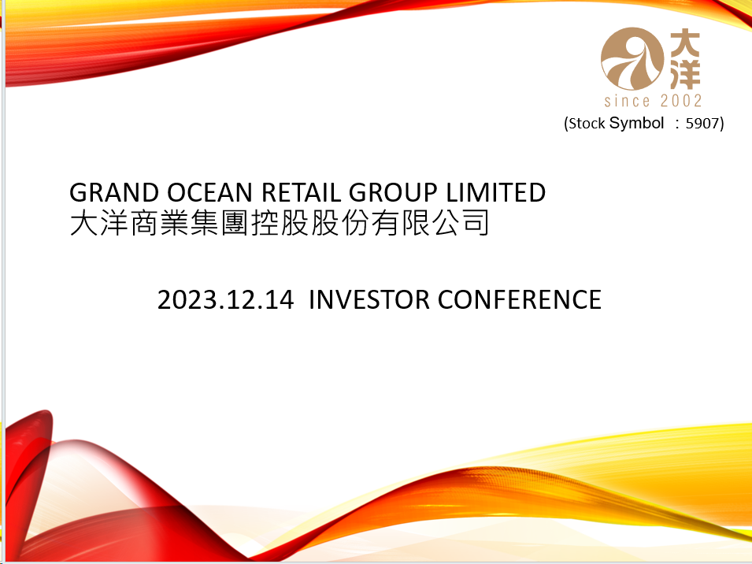
Business Development: Grand Ocean

Slide 15

Company Profile
Group Operating Base
Wuhan Zhongshan
Wuhan Guangu
Wuhan Grand Ocean Center (Nanguo)
Hubei Yichang
Hubei Shiyan
Nanjing Xinjiekou
Nanjing Jianbei
Anhui Hefei
14 Stores
Headquarters
Multi-Regional Setup
1000 TREES SHANGHAI
Hunan Hengyang
5 Provinces, 1 Municipalities
Fuzhou Donjiekou
Fuzhou Grand Classic
Fuzhou Underground Street
Fujian Quanzhou
Central China
East China
South China
3 Regions
9 cities

Slide 16
Financial Summary
Financial Analysis
Consolidated Statements of Comprehensive Income

Slide 17
Financial Analysis
Trend of Financial Liabilities
Trend of the Debt to Net Worth Ratio
Trend of Revenues, Operating Income, and Profit

Slide 18
Trend of Financial Liabilities
Unit：NTD in million
Debt
lease liabilities
Debt (exclude lease liabilities )

Slide 19
Trend of the Debt to Net Worth Ratio
Debt/Net Worth
Debt/Net Worth
Debt (exclude lease liabilities ) /Net Worth

Slide 20
Trend of Revenues, Operating Income, and Profit
Unit： NTD in million
Profit
Operating Revenues
Net Operating Income

Slide 21
Consolidated Statements of Comprehensive Income
Unit：NTD in million
Item | 2023.1-9 | % | 2022.1-9 | % | 2022 | %
Operating Revenues | 4,102 | 100 | 4,825 | 100 | 6,326 | 100
Operatin Costs | 1,405 | 34 | 1,520 | 32 | 2,007 | 32
Gross Profit from Operation | 2,697 | 66 | 3,305 | 68 | 4,319 | 68
Operating Expenses | 2,571 | 63 | 2,784 | 57 | 3,717 | 59
Net Operating Income | 126 | 3 | 521 | 11 | 602 | 10
Non-operating Income and Expenses | -591 | -14 | -461 | -10 | -739 | -12
(Loss) Profit from Operating before Tax | -465 | -11 | 60 | 1 | -137 | -2
Tax Expenses | 193 | 5 | 155 | 3 | 218 | 3
Loss | -658 | -16 | -95 | -2 | -355 | -6
Profit (Loss) (Owners of Parent) | -384 | -9 | 82 | 2 | 6 | 0
Basic EPS (NTD) | -0.47 |  | 0.10 |  | 0.01

Slide 22
Consolidated Statements of Comprehensive Income
Unit：NTD in million
Item | 2023 Q3 | % | 2022 Q3 | %
Operating Revenues | 1,244 | 100 | 1,524 | 100
Operating Costs | 441 | 35 | 487 | 32
Gross Profit from Operation | 803 | 65 | 1,037 | 68
Operating Expenses | 855 | 69 | 918 | 60
Net Operating (Loss) Income | -52 | -4 | 119 | 8
Non-operating Income and Expenses | -237 | -19 | -121 | -8
Loss from Operating before Tax | -289 | -23 | -2 | 0
Tax Expenses | 23 | 2 | 96 | 6
Loss | -312 | -25 | -98 | -6
Loss (Owners of Parent) | -220 | -18 | -25 | -2
Basic EPS (NTD) | -0.27 |  | -0.03

Slide 23

Business Vision
First
Steamship
(Holding)
Life Style
And
Integrated
Retail
Financial
Service
Property
Development
Shipping
Business

Slide 24

Thank You

